Slide 2
The video for this presentation can be found here

Slide 3
A Day in the Life of a Modern .NET Developer
Scott Hunter @coolcsh
Director of Program Management, .NET
Aditi Dugar @adugar19
Program Manager, .NET

Slide 4
The cloud journey
Servers
VMs
IaaS
VMs / Containers
PaaS
Microservices
Benefits
Reduced IT costs Cloud-native performance and scalability
Faster development times Build on common services
Agility Continuous delivery and innovation
On-premises servers
Cloud Infrastructure
Cloud-native
Notes:
As enterprises move through their cloud journey we’re now at a point where we need a cloud native development platform that can take full advantage of Platform as a Service (PaaS) offerings in any cloud, and hyper-scale. Applications that are born and hosted in the cloud provide a number of key benefits like reduction of IT spend, faster development times by taking advantage of cloud platform services, and increased agility with DevOps.
We understand you have existing investments that you want to also optimize to take advantage of some of these benefits. In this session I’m going to show you how you can move existing investments to the cloud as well as how to develop cloud-native apps with .NET Core

Slide 5
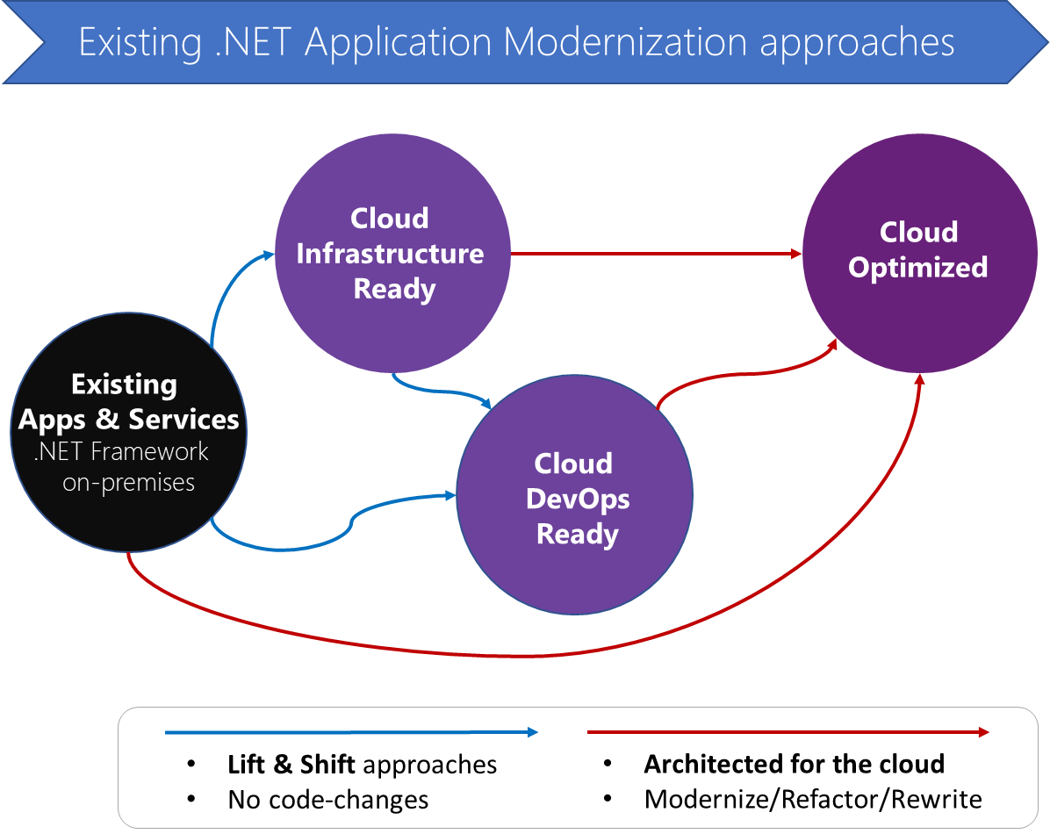
Cloud Maturity Model

Slide 6
Demo: Moving existing .NET investments to the cloud
Aditi Dugar

Slide 7
Moving to .NET Core

Slide 8
.NET Standard
TRADITIONAL WINDOWS
WINDOWS 10
WEB APPS, CLOUD SERVICES
MOBILE
IoT
AI
GAMES, VR, AR
.NET Standard allows sharing code, binaries and skills between .NET client, server and all of its flavors.
.NET Standard provides a specification for any platform to implement (conceptually similar to HTML)
All .NET runtimes provided by Microsoft are implementing the standard
.NET STANDARD
LIBRARIES
INFRASTRUCTURE
RUNTIME COMPONENTS
COMPILERS
LANGUAGES

Slide 9
.NET Standard 2.0
Has much bigger API surface
Extended to cover intersection between .NET Framework and Xamarin
Also makes .NET Core 2.0 bigger as it implements .NET Standard 2.0
+20K
More APIs than
.NET Standard 1.x
Can reference .NET Framework libraries
Compatibility shim allows referencing existing .NET Framework binaries
No recompile required – also covers existing NuGet packages
Limited to libraries that only use APIs that are available for .NET Standard
~70%
of NuGet packages
are API compatible

Slide 10
APIs in .NET Standard 2.0
DATA
DataSet • DataTable • SQLClient
XML
XLinq • XML Document • XPath • Schema • XSL
SERIALIZATION
BinaryFormatter • Data Contract • XML
NETWORKING
Sockets • HTTP • Mail • WebSockets
IO
Files • Compression • MMF
THREADING
Threads • Thread Pool • Tasks
CORE
Primitives • Collections • Reflection • Interop • Linq
Notes:
https://docs.microsoft.com/en-us/dotnet/standard/net-standard

Slide 11

Windows Compatibility Pack for .NET Core
Move to .NET Core runtime on Windows
Brings in Windows-specific APIs
System.Configuration
System.Drawing
System.Registry
And many more…
.NET FRAMEWORK
.NET CORE
MY APP

Slide 12
Demo: Windows Compatibility Pack for .NET Core
Scott Hunter

Slide 13
Modern Architectures

Slide 14
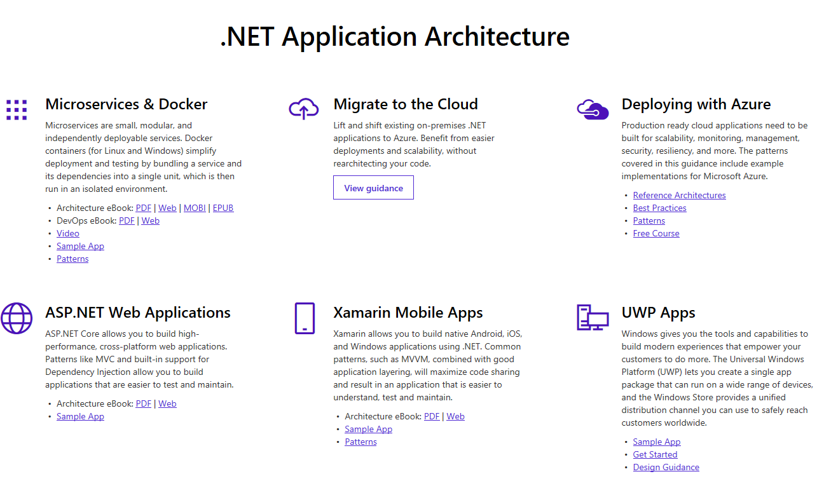
www.dot.net/architecture

Slide 15
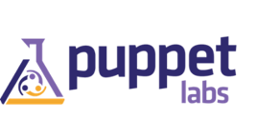


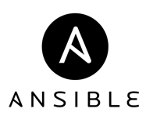















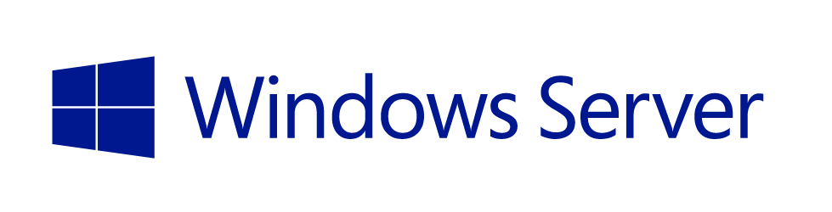








Choice + OSS + Flexibility with Azure
DEVOPS
DATABASES & MIDDLEWARE
APPLICATIONS
INFRASTRUCTURE
APP FRAMEWORKS
And great partner solutions…
Notes:
Choice + OSS + Flexibility with Azure.
With thousands of products available in the Azure Marketplace, you can literally support any application architecture.

Slide 16
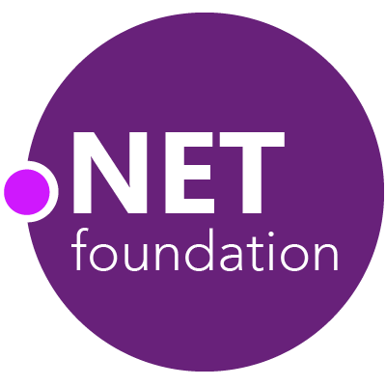
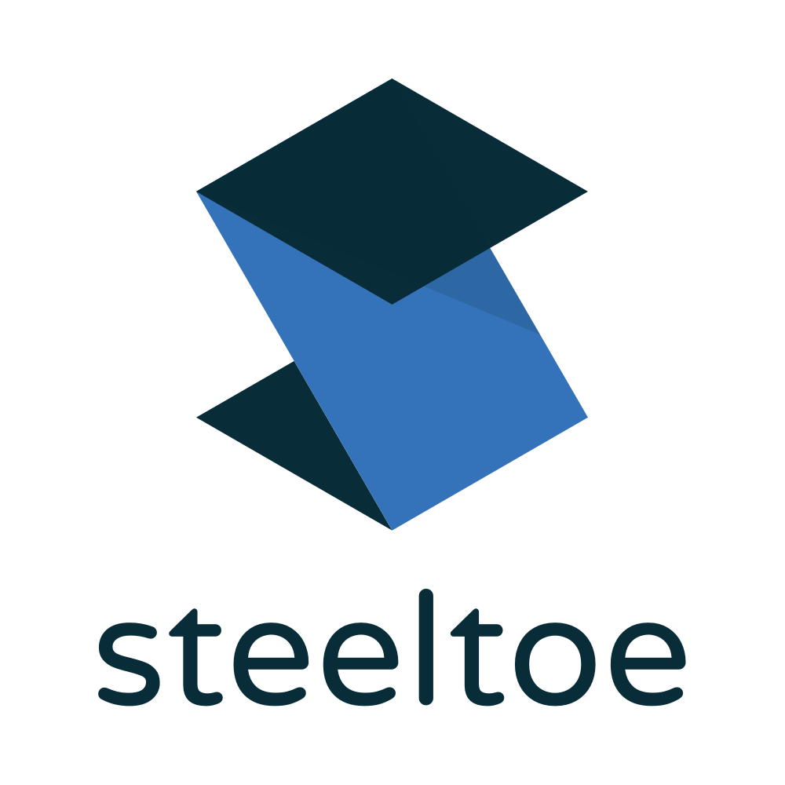
Welcome Steeltoe to .NET Foundation
Resilient .NET microservices
Cloud-native Security
Data Connectors
Service discovery with Netflix Eureka
Circuit breakers with Netflix Hystrix
Shared config with Spring Cloud Configuration Server
Integration with Cloud Foundry
Plus Management tools for production microservices
Notes:
Yesterday we announced a new project joining the .NET Foundation. I’m happy to welcome Steeltoe from Pivotal into the .NET Foundation. Steeltoe helps .NET developers build microservices based on the Netflix OSS patterns. The Spring Cloud project makes these solutions accessible to the broader Java community, now we are bringing them to the .NET community with Steeltoe.

Slide 17

Steeltoe
DotNetNuke
SourceLink
nUnit
MvvmCross
IronPython
ILMerge
Microsoft Web Protection Library
.NET Core
MSBuild
ASP.NET AJAX Control Toolkit
ASP.NET Core
Microsoft Azure WebJobs SDK
Salesforce Toolkits for .NET
MVVM Light Toolkit
Mailkit
WorldWide Telescope
Nancy
Open XML SDK
.NET SDK for Hadoop
MEF
Mimekit
xUnit
ASP.NET Web Pages
NuGet
IdentityManager
Couchbase Lite for .NET
macOS
macOS
Entity Framework
iOS
.NET ECOSYSTEM
WCF
Xamarin.Mobile
ASP.NET SignalR
.NET Micro Framework
Open Live Writer
Mono
Xamarin.Auth
Xamarin SDK
Orchard CMS
OWIN Authentication Middleware
ProtoBuild
IdentityServer
Microsoft Azure SDK for .NET
.NET Compiler Platform ("Roslyn")
Prism
ASP.NET Web API
Cake
Orleans
Kudu
Cecil
LLILC
Umbraco
System.Drawing
ASP.NET MVC
Notes:
The .NET Foundation is our center of gravity for open development and collaboration around the .NET ecosystem. The .NET Foundation has over 60 projects and hundreds of repos under its stewardship. And more than 25,000 developers from 1700 companies have contributed to .NET Core and related open source repositories, with over half of the contributions coming from outside Microsoft.
In addition to Steeltoe, we are also welcoming nUnit, MVVMCross, SourceLink, ILMerge, DotNetNuke and IronPython to the .NET Foundation.

Slide 18
Modern Web Development

Slide 19
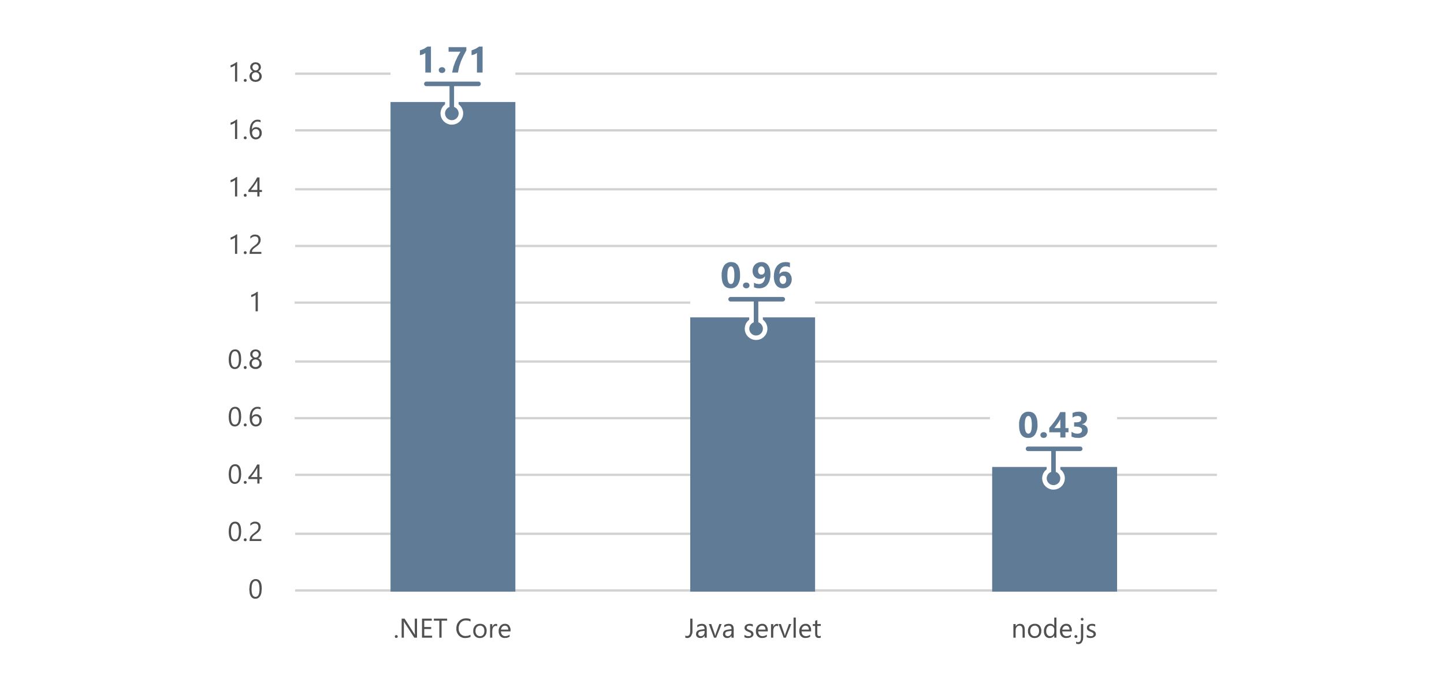
ASP.NET Core
Fastest mainstream web framework on the planet
Request / second (millions) based on latest official tests available at TechEmpower Round 14
Notes:
ASP.NET Core is almost twice as fast as Java servlets and 4 times faster then Node.js based on official results from TechEmpower’s latest Round 14. Additionally, ASP.NET Core MVC performance surpasses all popular web frameworks like Express and PHP.

Slide 20
ASP.NET Core 2.0
Razor Pages, Razor support for C# 7.2
Azure Diagnostics & Live Analytics
Production Debugging with SnapShots & SnapPoints
Angular and React templates
Authenticator app support in templates
CI/CD support for containers & App Service

Slide 21
Demo: Modern Web Development
Scott Hunter

Slide 22
Customer Success
Notes:
Scott, up to you if you want to keep this section. If you think you’ll have too much content, go ahead an kill it.

Slide 23
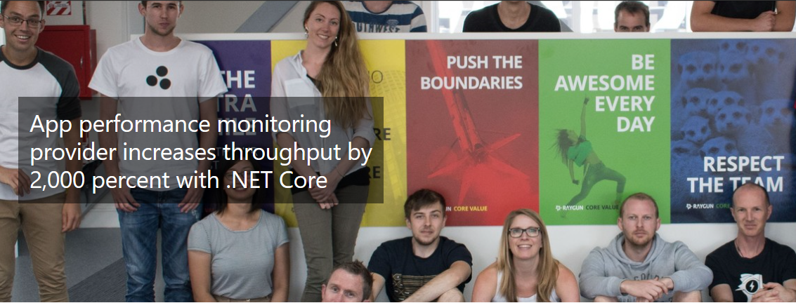

Notes:
http://customers.microsoft.com/en-us/story/raygun

Slide 24
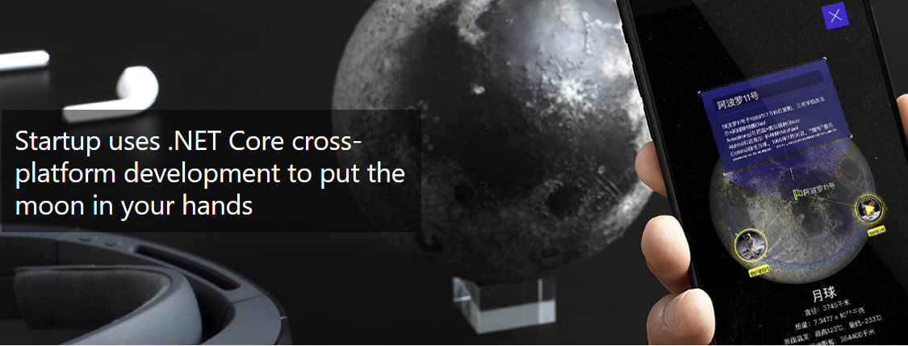

Notes:
https://customers.microsoft.com/en-us/story/quantum-technologies-discrete-manufacturing-azure

Slide 25


Slide 26

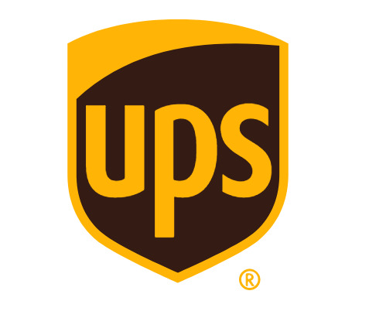
Notes:
https://customers.microsoft.com/en-us/story/ups

Slide 27






RayGun
"Using the same-size server, we were able to go from 1,000 requests per second per node with Node.js to 20,000 requests per second with .NET Core."
- John-Daniel Trask, CEO and Co-Founder
Read story
AstroReality, Quantum Technologies
"We think .NET Core is mature, very powerful, and a great choice for advanced modern apps."
- Zerlot Ma, Cofounder and CEO
Read story
Jet.com Inc.
"The event-driven, microservices paradigm eliminated a lot of the overhead that comes with a service-oriented architecture."
- Mike Hanrahan, CTO
Read story
Tencent
“The cross-platform capabilities of .NET Core were very important to us. Also, Microsoft designed .NET Core with a microservice architecture in mind, and that fits right in with our redesign plans.”
- Shanyou Zhang: Senior Software Architect
Read story
Age of Ascent, Illyriad Games
"Our game microservices are built using ASP.NET Core which gives us superior performance. ASP.NET is open source, that allows us to contribute back to it if we have any performance issues which Microsoft review and together we make a better product."
- Ben Adams, CTO and Co-founder
Read story
NetEase
".NET Core doesn't just help us get to market faster, it also enables our developers to focus on the core logic and what really matters, our players' experience. They don't have to deal with the communication gap and different ways of implementing the algorithm on the back and front end. They can just work on finding better ways to implement their ideas."
- Feng Zhou, Product Director
Read story
United Parcel Service (UPS)
"Xamarin allowed us to develop a single code base in C# and deploy the application to two completely different mobile phone ecosystems."
- Scott Hildebrand, Application Development Manager
Read story
GoDaddy
“Services can be developed more quickly, perform faster in production, and scale better if they’re written using .NET Core with C#.”
- Jeremiah Gowdy: Principal Software Architect
Read story
And many more: microsoft.com/net/customers
Notes:
BETH TODO: Tencent

